Slide 1


Search for resonant double Higgs production with bbZZ decays in the bbllνν final state
Ph.D. thesis defense (16 July 2019)
Rami Kamalieddin (UNLHEP)
Advisor: Professor Ilya Kravchenko

Slide 2
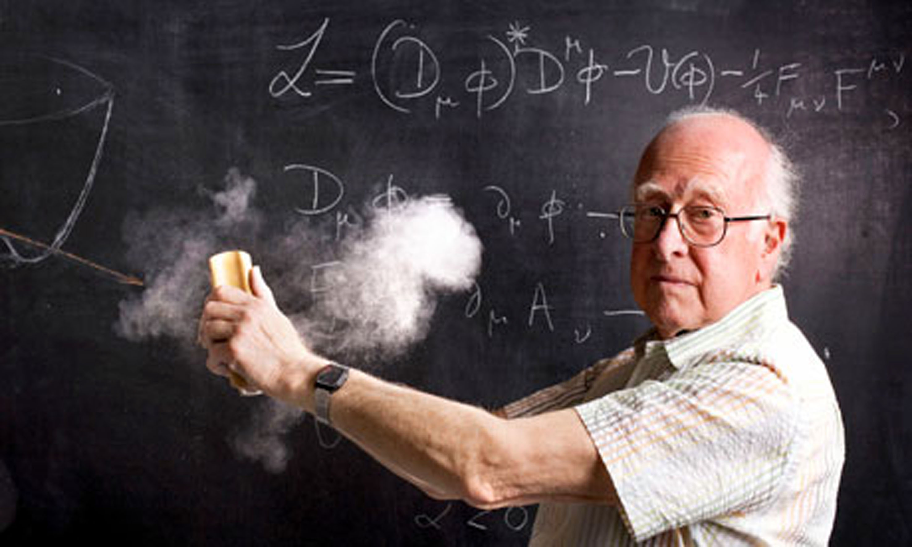
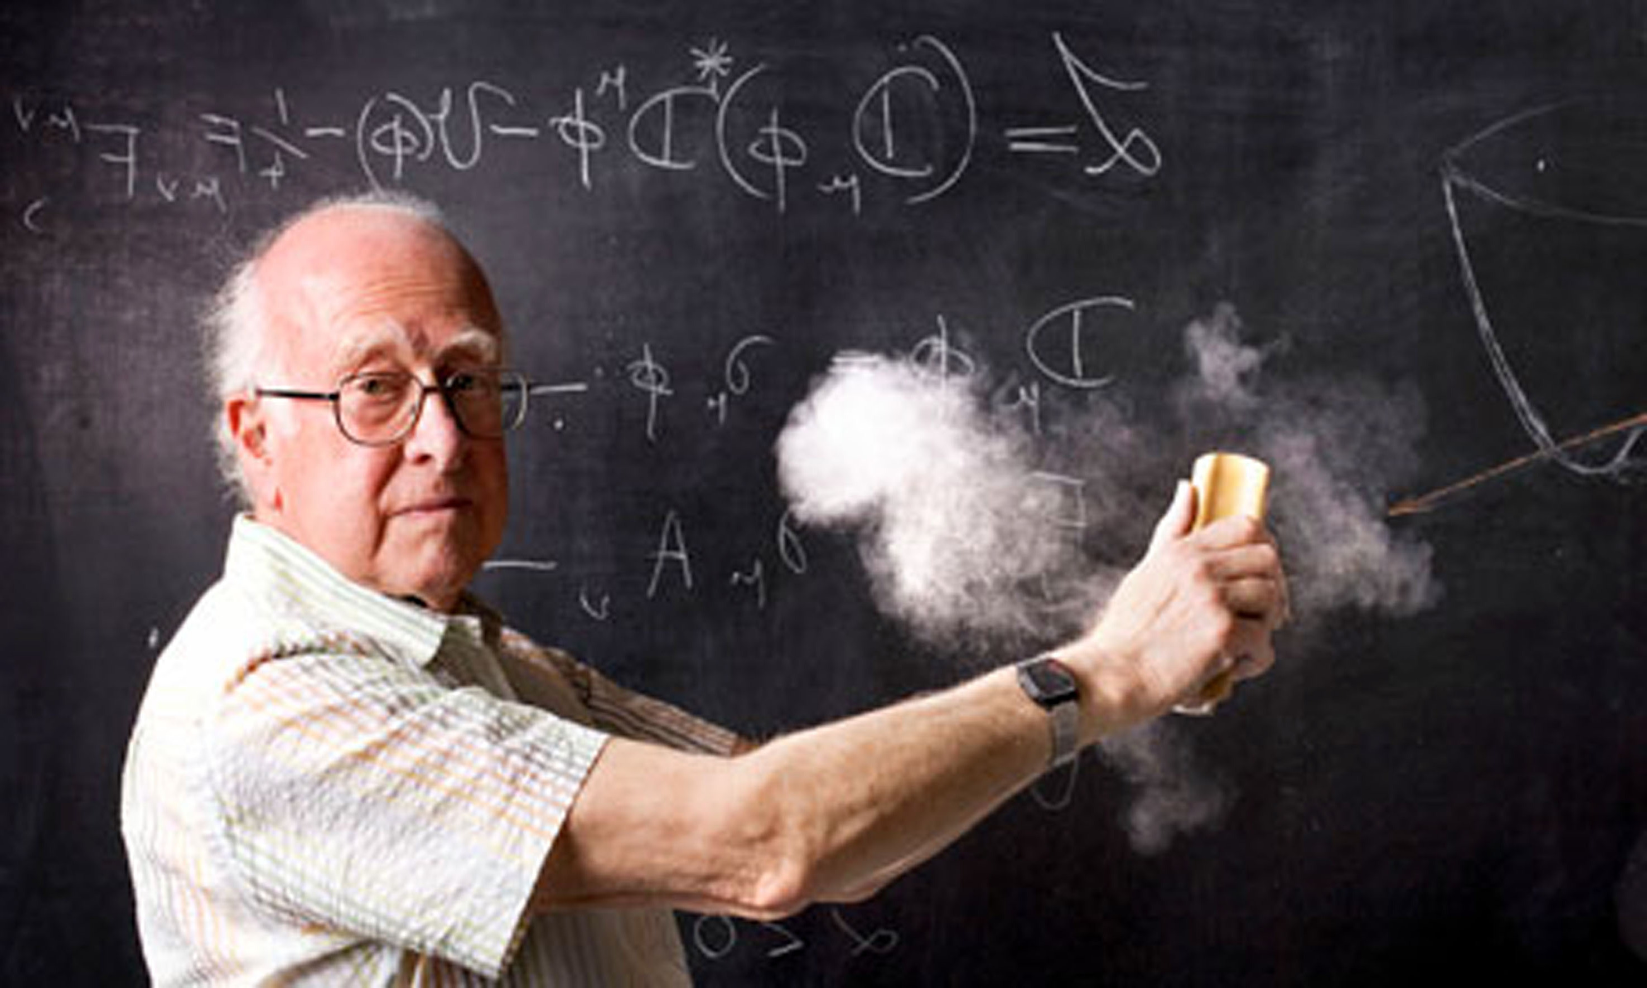
OUTLINE
• Double Higgs Theory
• Motivation for resonant double Higgs
• CMS detector
• Physics object reconstruction in CMS
• Physics data analysis
• Conclusions

Slide 3
The story
The problem:
Just a single Higgs is not enough to fully test the SM. Neither is it enough to shed light on which BSM theories are correct

Slide 4
The story
The problem:
Just a single Higgs is not enough to fully test the SM. Neither is it enough to shed light on which BSM theories are correct
The hero:
Double Higgs comes in handy ☺

Slide 5
The story
The problem:
Just a single Higgs is not enough to fully test the SM. Neither is it enough to shed light on which BSM theories are correct
The hero:
Double Higgs comes in handy ☺
The drama:
Double Higgs is not feasible with the current LHC data ☹

Slide 6
The story
The problem:
Just a single Higgs is not enough to fully test the SM. Neither is it enough to shed light on which BSM theories are correct
The hero:
Double Higgs comes in handy ☺
The drama:
Double Higgs is not feasible with the current LHC data ☹
The solution:
In BSM, the HH cross section is enhanced and we may be able to see it!

Slide 7
The story
The problem:
Just a single Higgs is not enough to fully test the SM. Neither is it enough to shed light on which BSM theories are correct
The hero:
Double Higgs comes in handy ☺
The drama:
Double Higgs is not feasible with the current LHC data ☹
The solution:
In BSM, the HH cross section is enhanced and we may be able to see it!
The action:
Let’s use CMSSW, Crab, GRID, Python, C++, Swan, TMVA, RooStats, Matplotlib etc … to DO IT!

Slide 8
Higgs and HH Theory

Slide 9
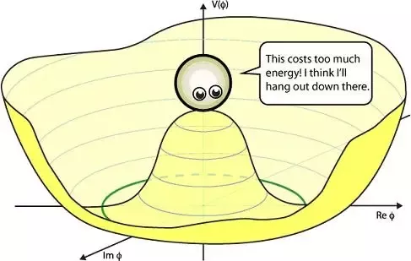
Higgs potential in the SM
Want to know the exact form of the Higgs potential
Need double Higgs to measure λ

Slide 10
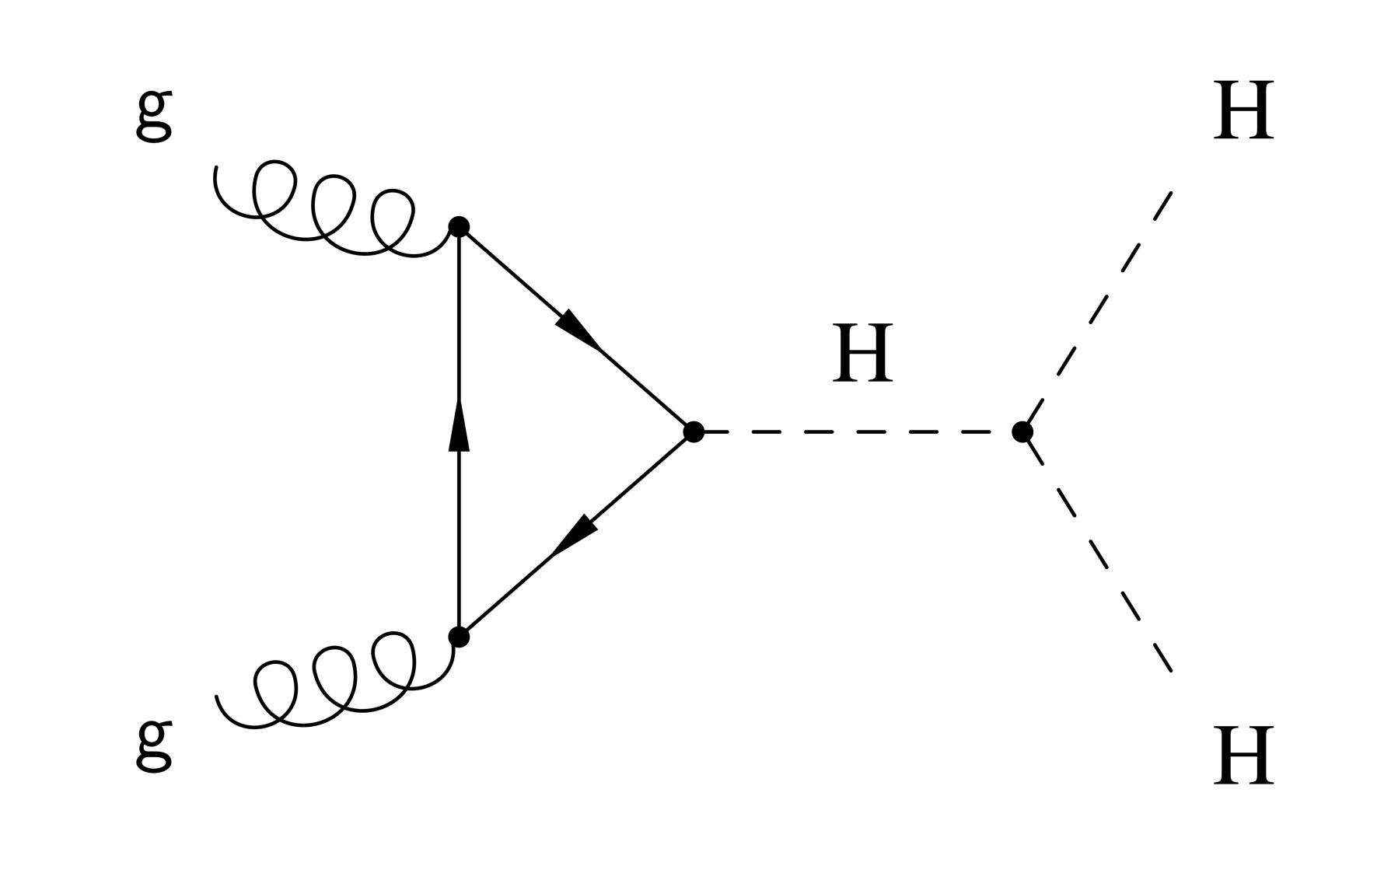
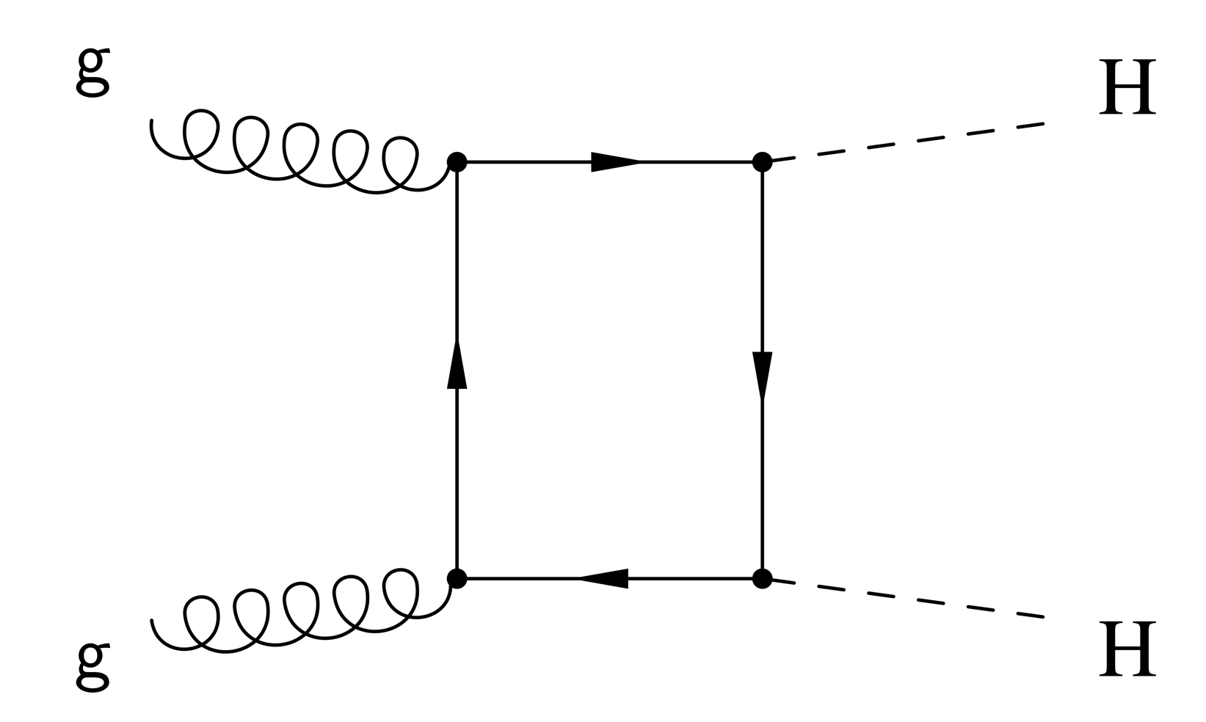
HH Theory in the SM
• In SM, HH production is non-resonant :
- Two diagrams interfering destructively
- Low cross section: σ^{HH}_{SM}≈ 33.45 fb at 13 TeV
• We are not sensitive to the SM HH with the current LHC data ☹

Slide 11
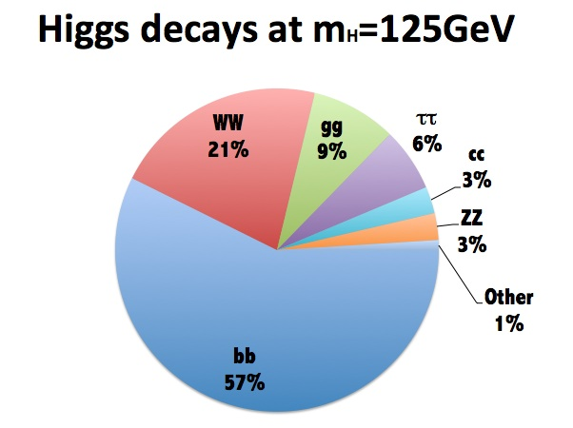
Higgs boson decays
• bb decay has the highest branching fraction
• ZZ* decay with Z to ee/μμ gives handles to improve the sensitivity

Slide 12
Motivation for the resonant double Higgs search

Slide 13
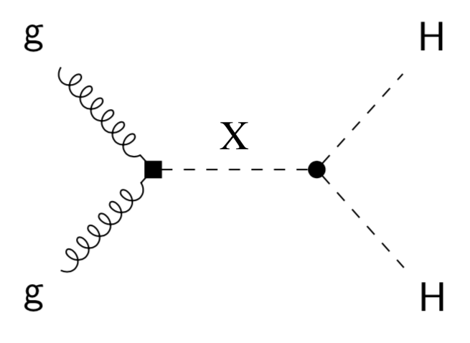
Motivation for the resonant HH
HH production in BSM could be resonant:
- Predicted by many BSM theories
- Modified coupling constants can significantly increase σ^{HH}
- Two types of particles: spin-0 (radion) and spin-2 (graviton)
- Model-independent strategy for experimentalists: look for ‘model
independent’ narrow width resonances

Slide 14
CMS detector

Slide 15
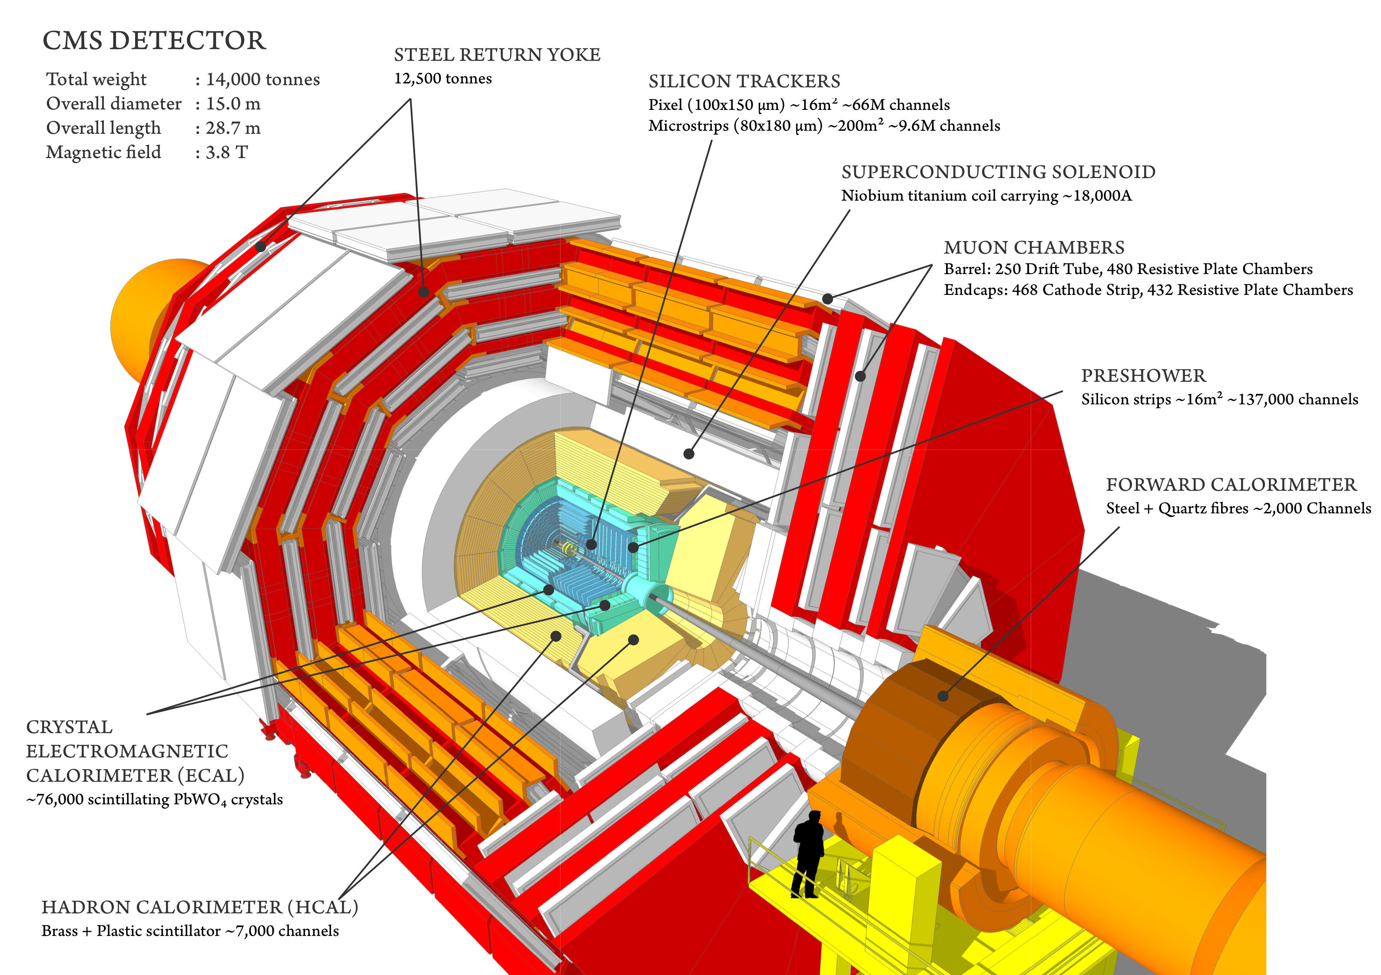
CMS detector

Slide 16
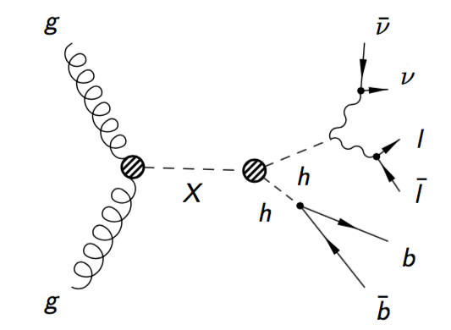
Physics objects of the 2b 2l 2ν signature
• Missing p_{T} from the off-shell Z* boson
• 2 leptons (ee, μμ) from on-shell Z
• 2 b jets from the Higgs ➔ bb
H ➔ ZZ*
H ➔ bb

Slide 17
Reconstructed physics objects
Jets:
Jets are collimated streams of particles. As jets propagate through the CMS detector, they leave tracks in the tracking system and interaction showers in the calorimeter crystals. We have two jets from Higgs to bb decays.
Electrons:
Leave tracks in the tracker and create a shower in the ECAL. Are coming from the on-shell Z boson decays.
Muons:
Leave tracks in the tracker, create a small shower in the ECAL, leave hits in the muon system, and escape the detector. Are coming from the on-shell Z boson decays.
Neutrinos or Missing p_{T}:
Neutrinos from off-shell Z bosons are not detected directly, their presence is inferred using the method of the missing transverse momentum.

Slide 18
Physics data analysis

Slide 19
bbZZ: 2b 2l 2ν signature
• MET from the off-shell Z* boson
• 2 leptons (ee, μμ) from on-shell Z
• 2 b jets from the Higgs ➔ bb
H ➔ ZZ*
H ➔ bb
Selected HH system decays maximize sensitivity:
• H to bb has the highest BF, thus increases number of candidates
• H to ZZ*, with on-shell Z to ll because resonant Z selection reduces backgrounds

Slide 20
Analysis setup

Slide 21
Analysis in a nutshell
HH decay in bb ll νν final state
Analysis flow is optimized for a narrow width (O (GeV)) heavy resonance search in the range 250 to 1000 GeV
BDTs are trained to optimize SR selection:
- 2 BDTs are used: low (≤450 GeV) and high mass regions
Signal extraction:
- Binned shape analysis
- To determine DY and tt SFs, simultaneously fit SR and CRs
- HH_Mt shape is used in the fits to extract limits vs mass
- 95% CL upper limits on the production σ of X_{spin 0/2} to HH to 2b2l2ν
We combine μμ and ee channels
Results are compared with the WED theory

Slide 22
Data, MC samples, and Triggers
DATA
Data collected during 2016:
- DoubleMuon and DoubleEG data sets
SIGNAL: 250 GeV → 1000 GeV
Gluon Fusion → X→ HH → bbZZ → 2b2l2ν for ‘ZZ part’ of signal, this is our signature
Gluon Fusion → X→ HH → bbWW → 2blνlν for ‘WW part’ of signal, which also enters our selection
BACKGROUND
Drell-Yan (DY) in association with 1→4 jets
top anti-top (tt)
Single top (ST), Dibosons, and ZH are minor background processes but also pass our selection
TRIGGERS:
1st Electron has p_{T} > 23 GeV and 2nd Electron has p_{T} > 12 GeV
1st Muon has p_{T} > 17 GeV and 2nd Muon has p_{T} > 8 GeV

Slide 23
Event selection

Slide 24
Event selection
• Z boson and Higgs boson candidates:
- Z(μμ): two opposite-sign muons with p_{T} > 20/15 GeV
- Z(ee): two opposite-sign electrons with p_{T} > 25/15 GeV
- H(bb): a pair of b-jets with the highest CMVAv2 discriminant value
• On the way to HH system:
- ≧ 2 b-jets
- 20 GeV < H_{bb} mass
- 2 leptons
- 76 GeV < Z_{ll} mass to be orthogonal to bbWW measurement
- Missing p_{T} selection to be orthogonal to bbZZ in 2b2l2q state
- Z_{ll} + H_{bb} + missing p_{T} ≈ HH candidate
- Requirement on the pseudo-transverse
mass of HH ≧ 100 GeV

Slide 25
Signal and control regions
Three regions are defined:
Signal Region (SR): Z_{ll} mass = [76, 106], H_{bb} mass = [90, 150]
Control region DY (CRDY): Z_{ll} mass = [76, 106], H_{bb} mass = ]90-150[
Control region TT (CRTT): Z_{ll} mass > 106, H_{bb} mass = [90, 150]
CRDY
20 90 150 Hbb mass
SR
CRTT
CRDY
76 106 Zll mass

Slide 26
Background reduction

Slide 27
BDT discriminant
To reduce background contamination in the SR: require a BDT selection
BDTs are trained on bbZZ signal vs DY&tt events
BDT selections are optimized for each mass hypothesis in 250 → 1000 GeV and each channel (ee/μμ) separately to yield the lowest limit
The mass range is split into two:
- Low mass (250 → 450 GeV)
- High mass (500 → 1000 GeV)
The input to BDT is a set of nine variables:
- M_{T} and p_{T} of Z boson and Higgs boson candidates
- ΔR between leptons and ΔR between b jets
- Missing p_{T} (MET)

Slide 28
BDT Performance
Low mass region
High mass region
Di-electron channel, graviton hypothesis

Slide 29
Data-MC disagreements

Slide 30
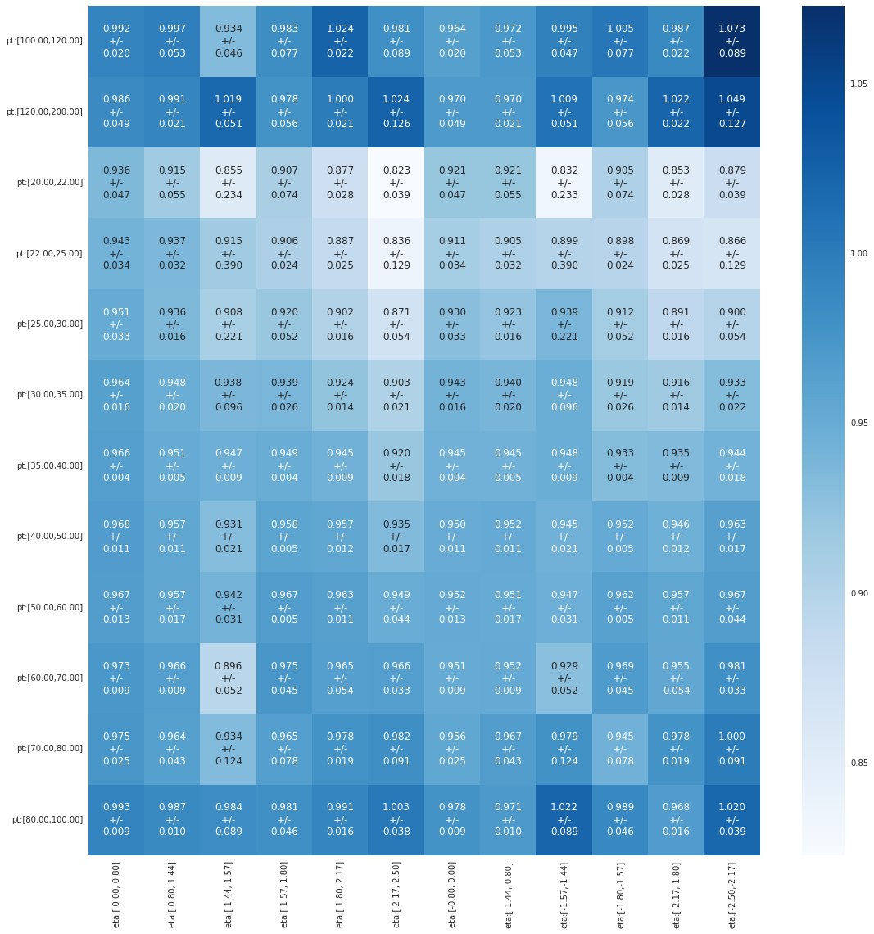
Data-MC discrepancies
• Lepton efficiencies
• b tagging and light flavor mistagging probability
• Kinematic reweighting of the DY plus jets samples
- Δη_{bb}
- p_{T}(Z)
p_{T} slices from 20 to 200 GeV
η slices from -2.5 to 2.5
*Electron ID&ISO scale factors as a function of electron p_{T} and η

Slide 31
Maximum likelihood fit
Index i is reserved for bins of the input distributions
Index j is reserved for uncertainties
n_{i} is the number of observed data events in the bin i
Index k refers to the background process k, and B_{k,i} is the content of the bin i of the background shape for a process k, and S_{i} is the content of the bin i of the signal shape
The parameter r_{k} sets the normalization of the background process k, while r_{signal} is the signal strength parameter
All r parameters float freely in the fit

Slide 32
Systematics

Slide 33
Uncertainties
Normalization:
• Luminosity
• PDF uncertainties
• QCD scale variations
• Cross section normalization
• Pile up
• MET
• Drell-Yan and tt
normalizations
Shape:
• Lepton Scale factors: split into all components
• Jet Energy Scale
• Jet Energy Resolution
• Tagging of a b jet
• Mistagging of a b jet
• Bin-by-Bin MC uncs

Slide 34
Results

Slide 35
Post-fit HH_Mt in SR and CRs
m+m- e+e-
radion (spin 0)
CRDY CRTT SR

Slide 36
Post-fit HH_Mt in SR and CRs
m+m- e+e-
graviton (spin 2)
CRDY CRTT SR

Slide 37
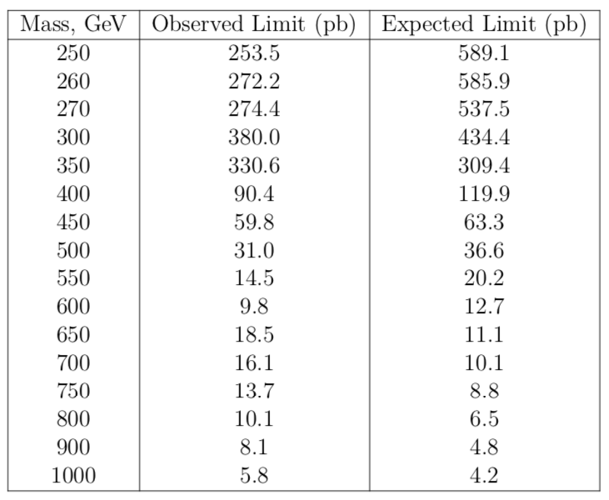
95 % CL upper limits
graviton(spin 2)
http://cds.cern.ch/record/2648796?ln=en

Slide 38
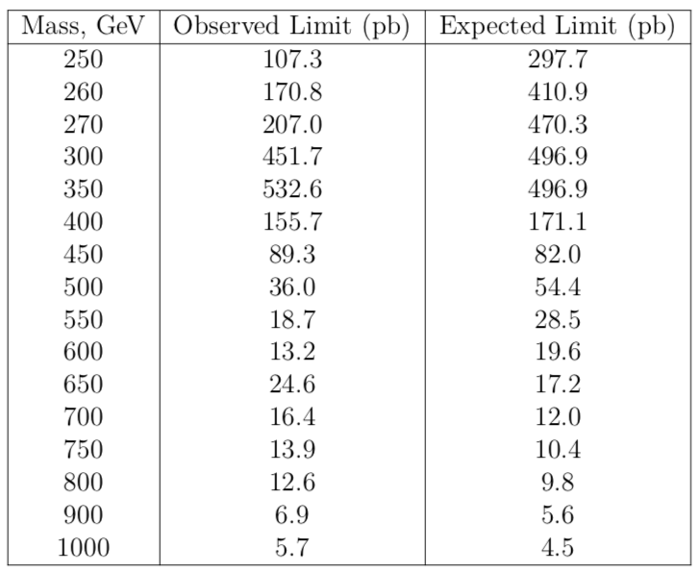
95 % CL upper limits
radion (spin 0)
http://cds.cern.ch/record/2648796?ln=en

Slide 39
Summary
• We have presented the search for resonant HH production with bbZZ decays in 2b2l2ν final state using 35.9 fb⁻¹ of data collected in 2016
• Main backgrounds are DY and tt: fit simultaneously (ML fit) signal and control regions to determine their normalizations
• Use BDTs to reduce background contamination in the signal region
• Combination of ee and μμ channels was used to derive expected limits as a function of mass of a narrow width spin 0/2 resonance decaying to HH
• Interpretation of results is done in WED theory
• This is the world-first search for double Higgs boson production in the bbZZ
intermediate channel

Slide 40
40
Backup material

Slide 41
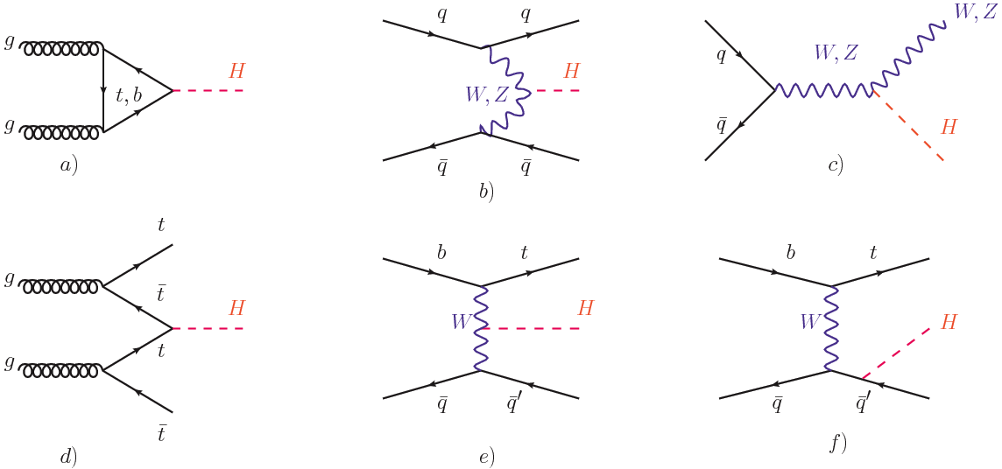
Single Higgs boson production
87% 7% 5%
0.5% <0.5% <0.5%

Slide 42
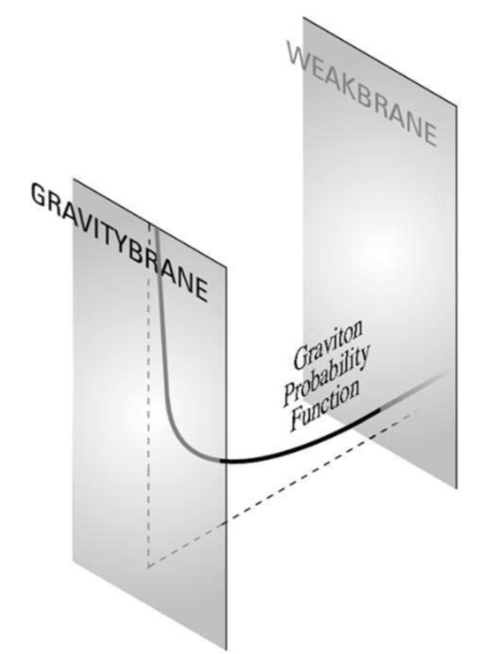
WED space structure

Slide 43
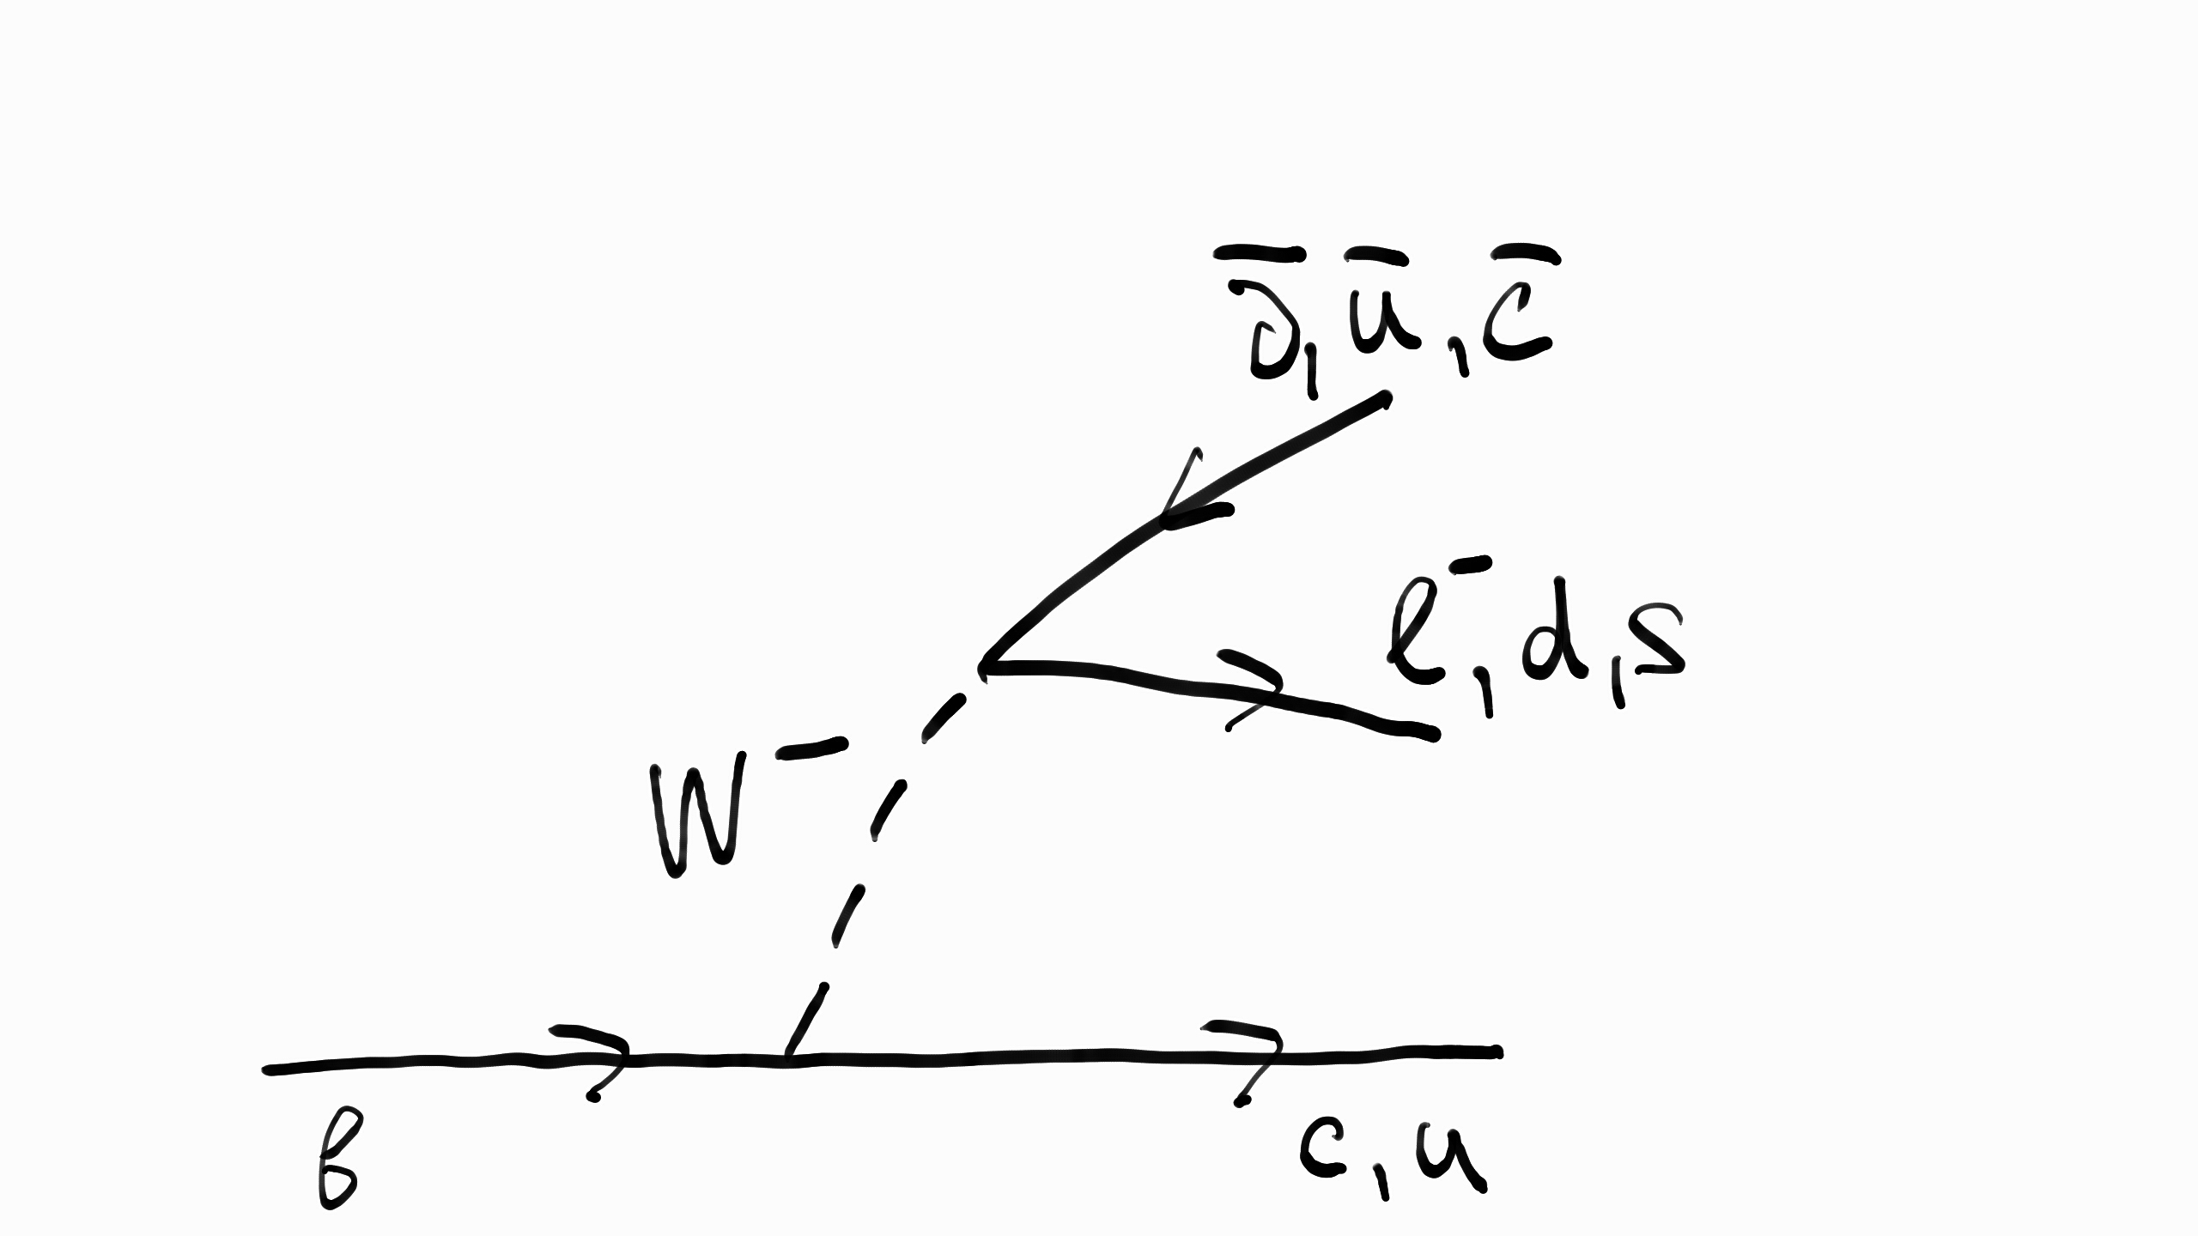
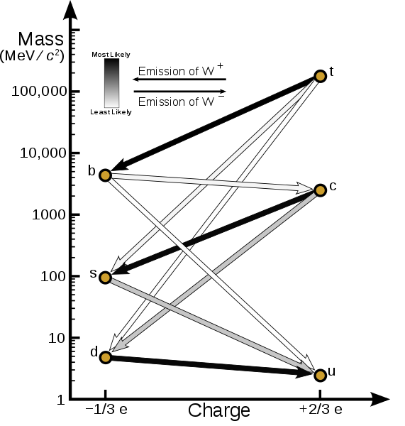
B quark decays

Slide 44
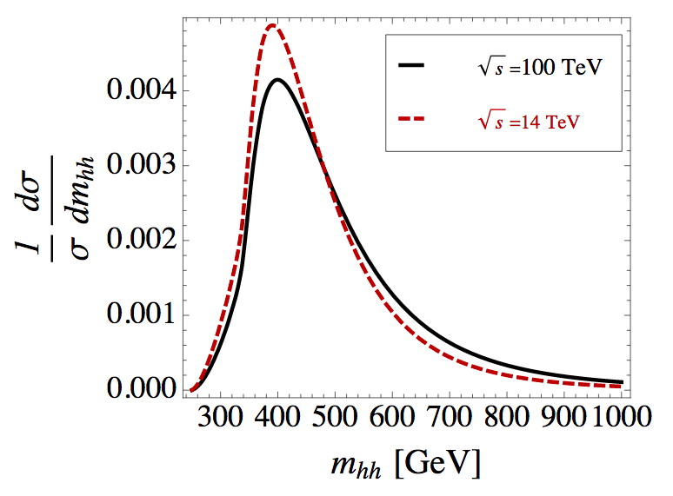
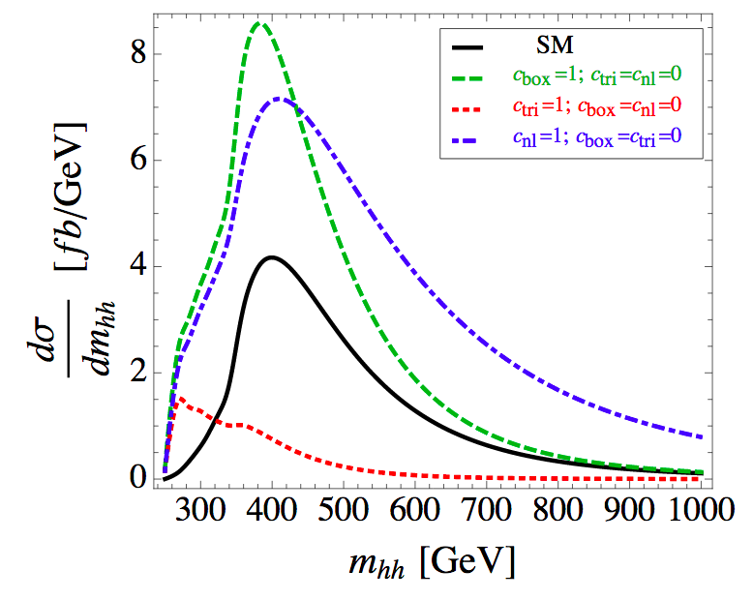
Double Higgs boson mass distribution in the SM at the LO
Left: Comparison of the double Higgs boson mass distribution in the SM at the LO at 14 and 100 TeV center-of-mass energy.
Right: the total SM HH cross section and the individual contributions.
Green refers to the SM box production, red refers to the SM triangle production, and blue refers to BSM non-linear ttHH production, not included in the total SM production (in black)

Slide 45
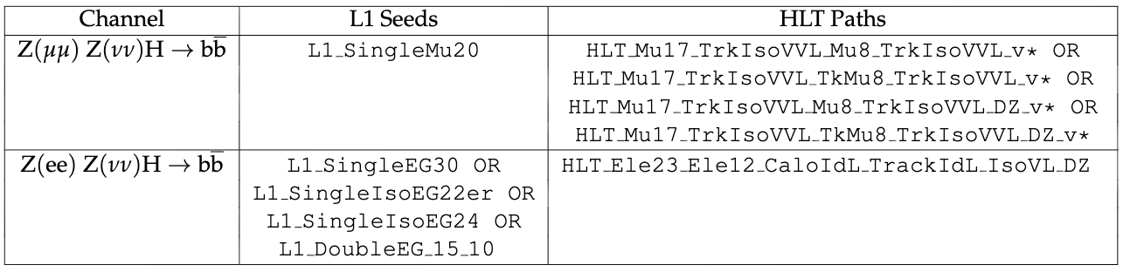
Triggers
Triggers for dimuon and dielectron analysis channels both at L1 and HLT levels.

Slide 46
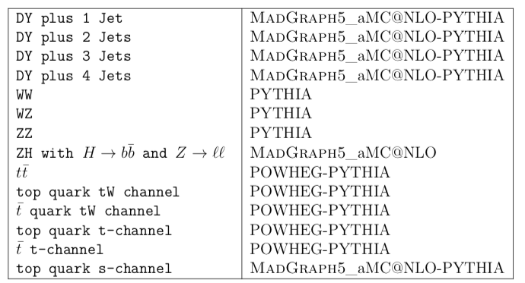
MC samples
Signal samples and DY are at LO using MadGraph5_aMC@NLO, Pythia for parton showering and hadronization
DY is reweighted to NLO using Δη_{bb} and p_{T}(Z)
Top quark at NLO:
1) t-channel, tW, tt using POWHEG
2) s-channel using MadGraph5_aMC@NLO
Single top is rescaled to NNLO
Dibosons at LO using Pythia and rescaled to NLO
ZH at NLO using MadGraph5_aMC@NLO and rescaled to NNLO

Slide 47
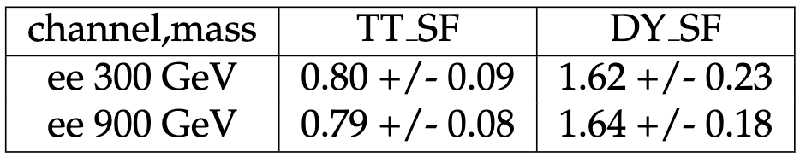
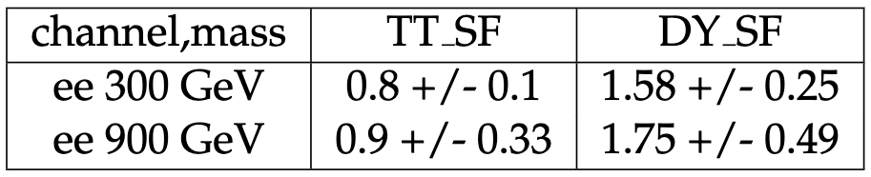
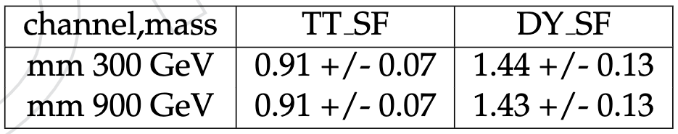
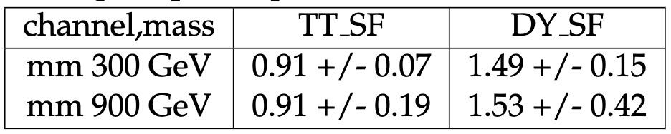
DY and TT SFs from the fit
Normalization for backgrounds, final numbers after the application of all the nui-sances during the postfit procedure. Electron channel. All regions are used.
Normalisation for backgrounds in the unblinded SR only, final numbers after the applica-tion of all the nuisances during the postfit procedure. Electron channel.
Normalization for backgrounds, final numbers after the application of all the nui-sances during the postfit procedure. Muon channel. All regions are used.
Normalisation for backgrounds in the unblinded SR only, final numbers after the applica-tion of all the nuisances during the postfit procedure. Muon channel.

Slide 48
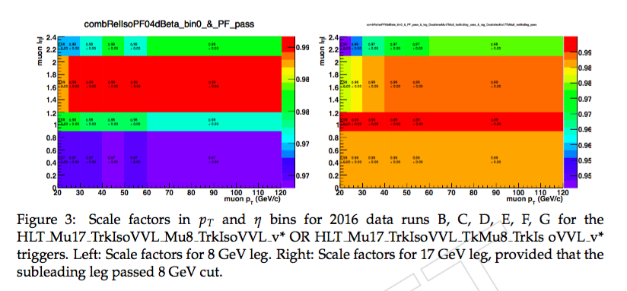
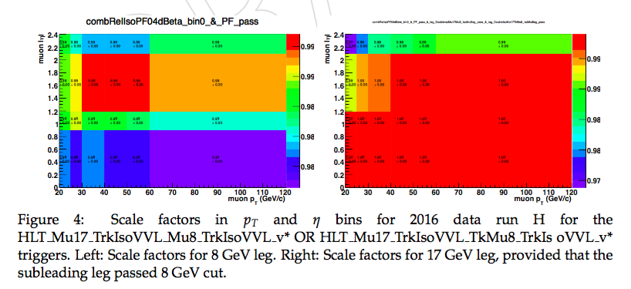
HLT SFs for dimuon triggers
HLT_BIT_HLT_Mu17_TrkIsoVVL_Mu8_TrkIsoVVL_v or HLT_BIT_HLT_Mu17_TrkIsoVVL_Mu8_TrkIsoVVL_DZ_v or HLT_BIT_HLT_Mu17_TrkIsoVVL_TkMu8_TrkIsoVVL_v or HLT_BIT_HLT_Mu17_TrkIsoVVL_TkMu8_TrkIsoVVL_DZ_v

Slide 49
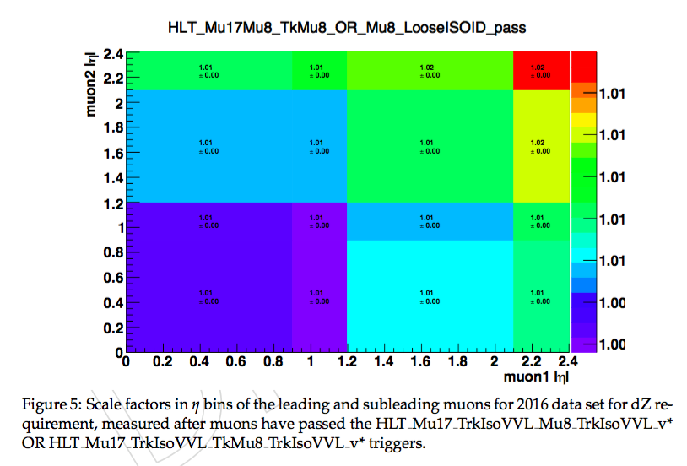
HLT SFs for dimuon triggers, dZ requirement
HLT_BIT_HLT_Mu17_TrkIsoVVL_Mu8_TrkIsoVVL_v or HLT_BIT_HLT_Mu17_TrkIsoVVL_Mu8_TrkIsoVVL_DZ_v or HLT_BIT_HLT_Mu17_TrkIsoVVL_TkMu8_TrkIsoVVL_v or HLT_BIT_HLT_Mu17_TrkIsoVVL_TkMu8_TrkIsoVVL_DZ_v
https://indico.cern.ch/event/636555/contributions/2577291/attachments/1453162/2241537/TnP_DoubleMuSF_03_05_17.pdf

Slide 50
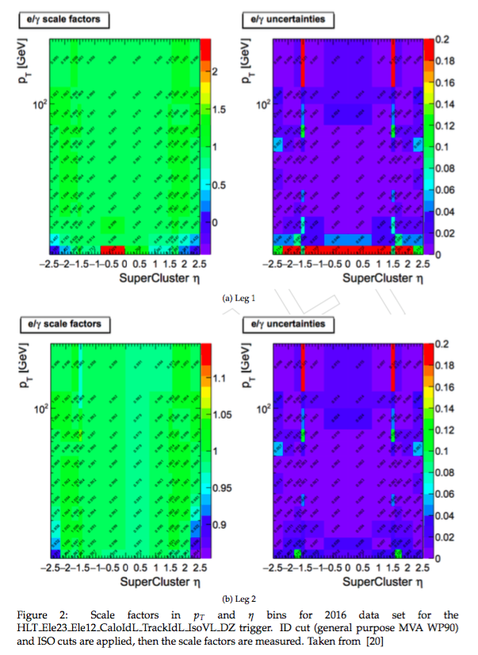
HLT SFs for dielectron trigger
HLT_BIT_HLT_Ele23_Ele12_ CaloIdL_TrackIdL_IsoVL_DZ_v
https://indico.cern.ch/event/604949/contributions/ 2543520/attachments/1439974/2216426/VHbb_TnP _SFs_egamma_april.pdf#search=vhbb%20AND %20cerntaxonomy%3A%22Indico%2FExperiments% 2FCMS%20meetings%2FPH%20%2D%20Physics%2FEgamma%22

Slide 51
Analysis strategy
Object selection
Select
Candidate
Prepare input to Combine
Limits
Requirements on leptons, jets and met
BDT with nine variables
‘Simple shape’
of HH_m_{T}
Derive the best limits we can
Our objective is:
• Set 95% CL upper limit on σ(pp X HH) vs mass of X (where X is the spin 0/2 narrow width resonance)
The method we will use to achieve it:
• Binned shape analysis using Higgs Combination Tool

Slide 52
Physics objects and corrections
Jets:
- Particle Flow anti-k_{T} (Charged Hadron Subtracted) jets, JES and JER corrections are applied.
- Loose jet ID and PU-ID applied, also p_{T} > 30 GeV and |η| < 2.4
b tagging
- CMVAv2 algorithm that uses 6 simpler taggers, WP Medium is applied
- b tagging/mistagging scale factors applied as weights
Electrons:
- MVA Identification WP Loose, p_{T} > 25/15 GeV and |η| < 2.5. Identification (ID), Isolation (ISO), High-level Trigger (HLT) scale factors (SFs) are applied
- Particle Flow relative isolation < 0.06 (ρ-subtracted, cone ΔR = 0.3)
Muons:
- Loose global muon, p_{T} > 20/15 GeV and |η| < 2.4, ID, ISO, TRK, HLT SFs
- Particle Flow relative isolation < 0.15 (Δβ-subtracted, cone ΔR = 0.4)
Missing p_{T}:
- Particle Flow missing p_{T} with all needed corrections

Slide 53
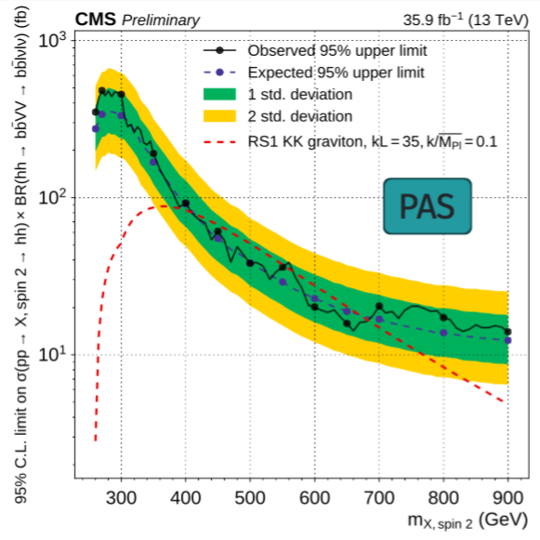
Zll cut to be orthogonal to bbWW
Shown just to make the orthogonality point
bbZZ bbWW is O(20) more sensitive
Known approved bbVV (bbWW) analysis operates strictly in the range Z_{ll} mass < 76 GeV
We work in the region Z_{ll} mass > 76 GeV
In our analysis space bbWW to bbZZ fraction is 1 to 4

Slide 54
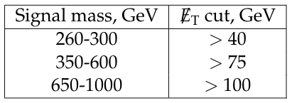
MET cut to be orthogonal to 2b2l2q
MET selection for us (and for 2b2l2q) was developed by both teams together to achieve the best limit for the bbZZ combination

Slide 55
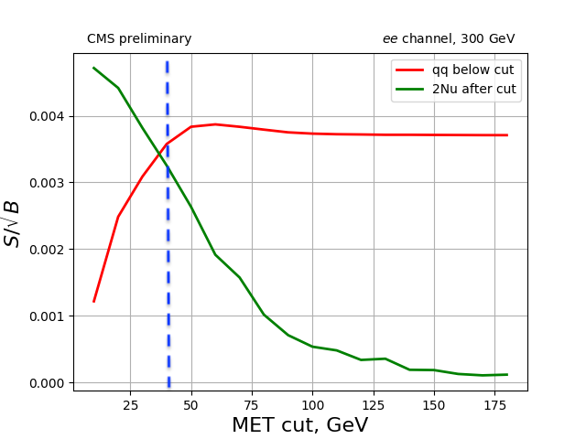
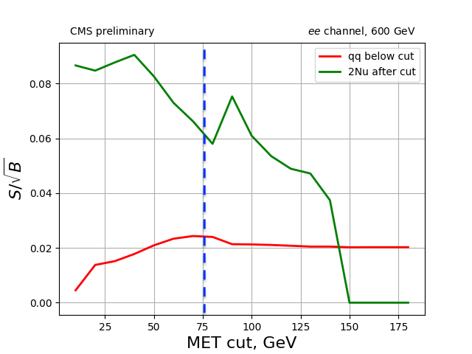
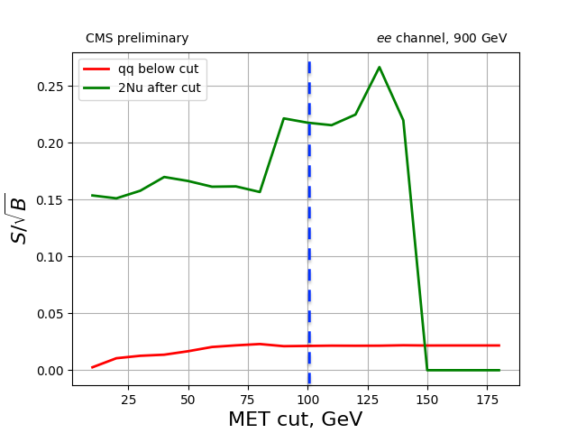
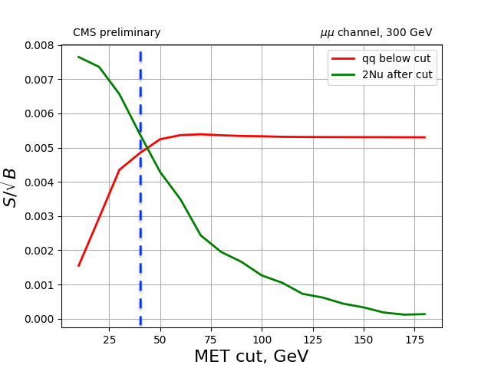
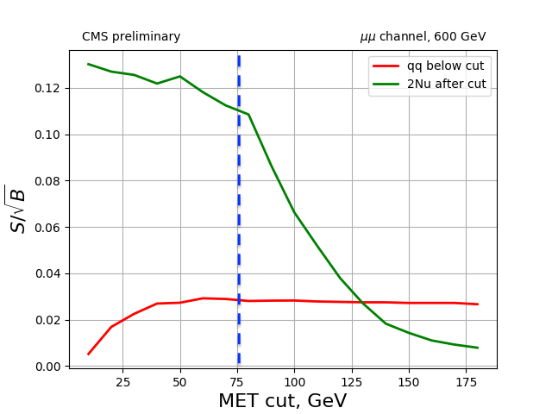
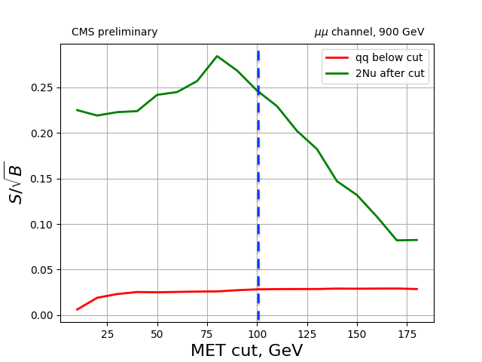
MET cut to be orthogonal to 2b2l2q, cont.

Slide 56
Correlations, ee, low

Slide 57
Correlations, ee, high

Slide 58
Variables, graviton, ee, low
Index ’1’ refers to H → bb decay and index ’0’ refers to H → ZZ decay.

Slide 59
Variables, graviton, ee, high
Index ’1’ refers to H → bb decay and index ’0’ refers to H → ZZ decay.

Slide 60
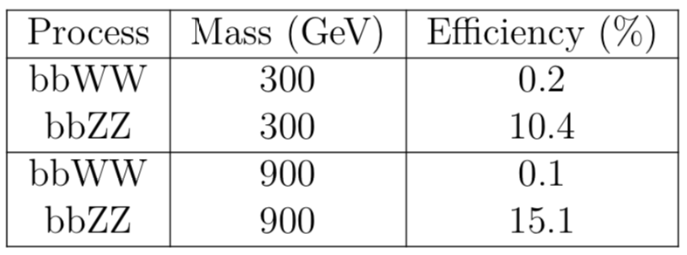
Event selection in the SR before BDT
Fraction of events surviving the candidate selection and kinematic requirements. Efficiencies are given for bbZZ and bbWW contributions in the SR and are normalised to the initial event counts before any selection is applied. A di-muon channel is presented. Numbers for the di-electron channel have the same trend but lower values, because in CMS efficiencies for electrons are lower than for muons.

Slide 61
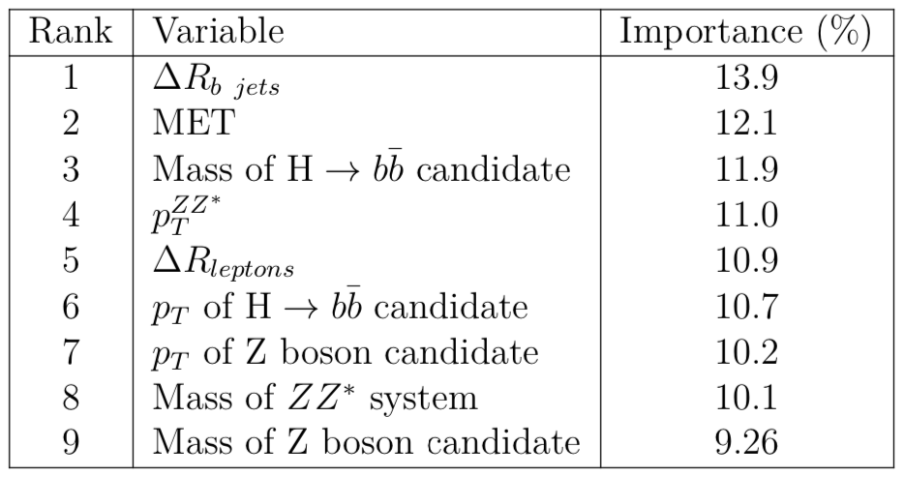
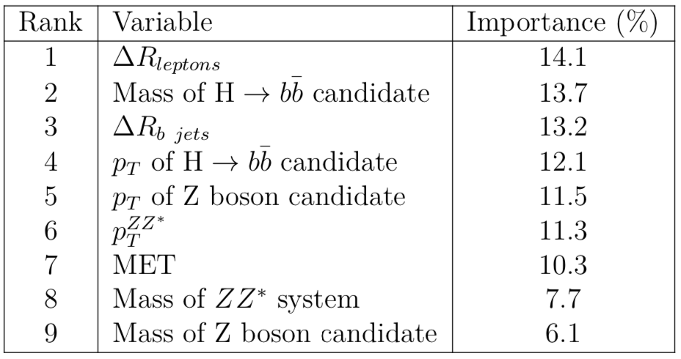
Importance of BDT variables, ee
Relative importance of the input ^{variables in the low mass} ^{BDT training.}
Relative importance of the input ^{variables in the high mass} ^{BDT training.}

Slide 62
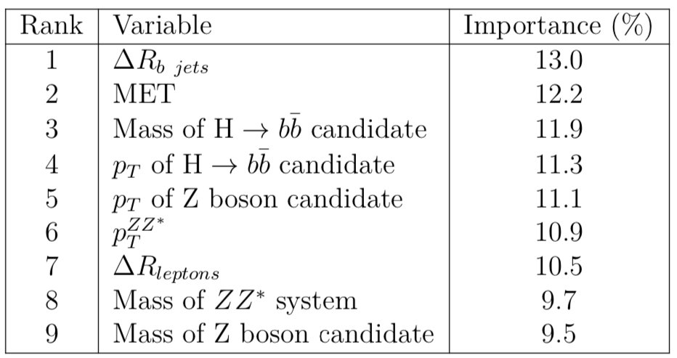
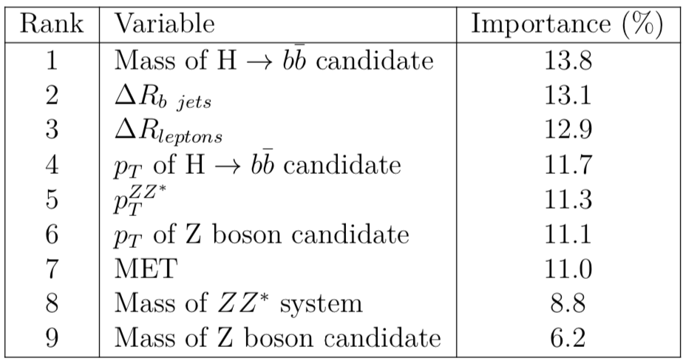
Importance of BDT variables, μμ
Relative importance of the input ^{variables in the low mass} ^{BDT training.}
Relative importance of the input ^{variables in the high mass} ^{BDT training.}

Slide 63
Low mass BDT
This is the region where backgrounds look very much signal-like, hard to get very high performance
electrons muons

Slide 64
High mass BDT
This is the region where signal is highly boosted, performance is noticeably higher
electrons muons

Slide 65
BDT distributions
m+m- e+e-
graviton (spin 2)
CRDY CRTT SR

Slide 66
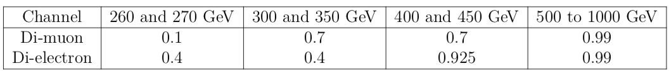
BDT optimization
• We are statistics dominated, so keep all uncertainties as lnN, otherwise it will take absurdly long to compute the result.
• Optimize each channel separately.
• Use as few cuts across the whole mass range as possible if it does not hurt the performance but helps to simplify the analysis and/or to avoid wasting weeks of computing time.

Slide 67
Cross check of BDTs and mass regions
Low mass BDT applied at high mass region - worse!
High mass BDT applied at 450 GeV mass region: good!
Apply high BDT all the way to the left until it is worse than low BDT. Answer - already at 400 GeV the limit with:
Original (low mass) BDT: r < 49.97
High mass BDT applied : r < 81.88

Slide 68
Electron channel
Cuts: Best Subopt.
0.4 0.4 0.4
Numbers represent cuts used in the analysis
0.4 0.925 0.925
0.99 0.99 0.99

Slide 69
Muon channel
0.1 0.1 0.7
Cuts: Best Subopt.
0.7 0.7 0.7
0.99 0.99 0.99

Slide 70
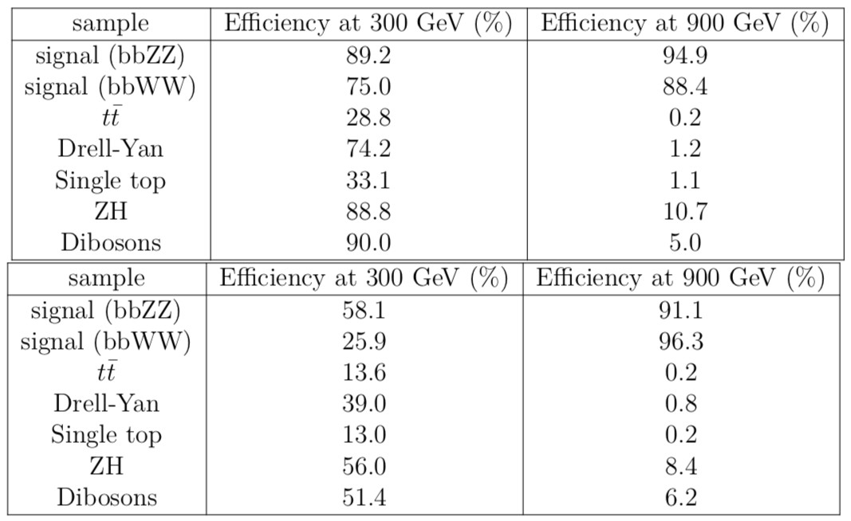
BDT efficiency
Efficiency of the BDT selection in two mass regions and for two channels: ee channel (top) and μμ channel (bottom). BDT selection at 300 ^{GeV} ^{is 0.4(ee) and 0.7(μμ)}

Slide 71
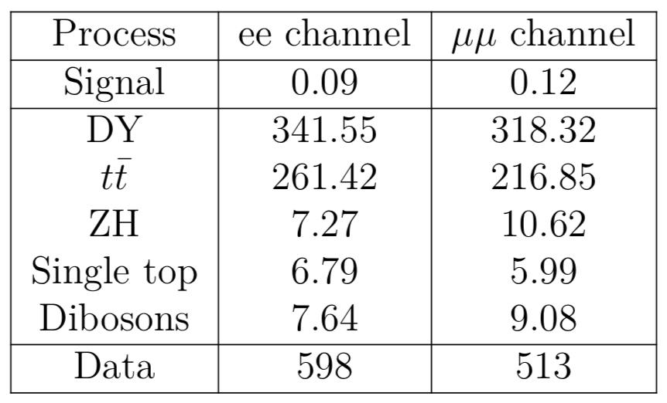
Expected event yield
Expected event yields and observed data counts in the SR, split by channel. 300 GeV graviton mass hypothesis. Signal is normalized to 1 pb cross section. BDT selection is 0.4 for the ee, and 0.7 for μμ.

Slide 72
Systematics: impacts

Slide 73
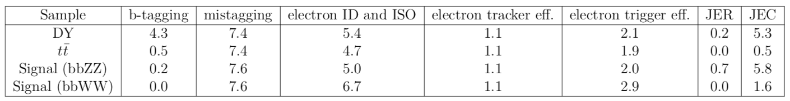
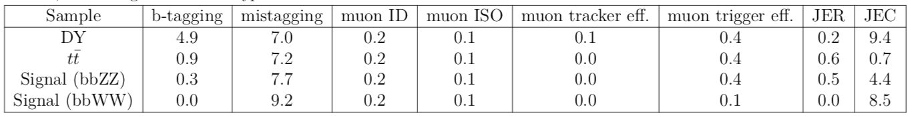
Leading systematic uncertainties
The effect of leading systematic uncertainties on the total event yield for main signal and background processes, ee channel, 300 GeV graviton mass hypothesis.
The effect of leading systematic uncertainties on the total event yield for main signal and background processes, μμ channel, 300 GeV graviton mass hypothesis.

Slide 74
Derivation of the expected limits
• Normalize signal samples to HH xsec of 1pb
• Use bbZZ (~0.0012) and bbWW(~0.0266) known BFs
• A fit of all regions simultaneously in order to extract the signal strength as well as the
normalization of DY and TT backgrounds
• Obtained value of ‘r’ is 95% CL upper limit on σ(pp ➔ X ➔ HH) in pb

Slide 75
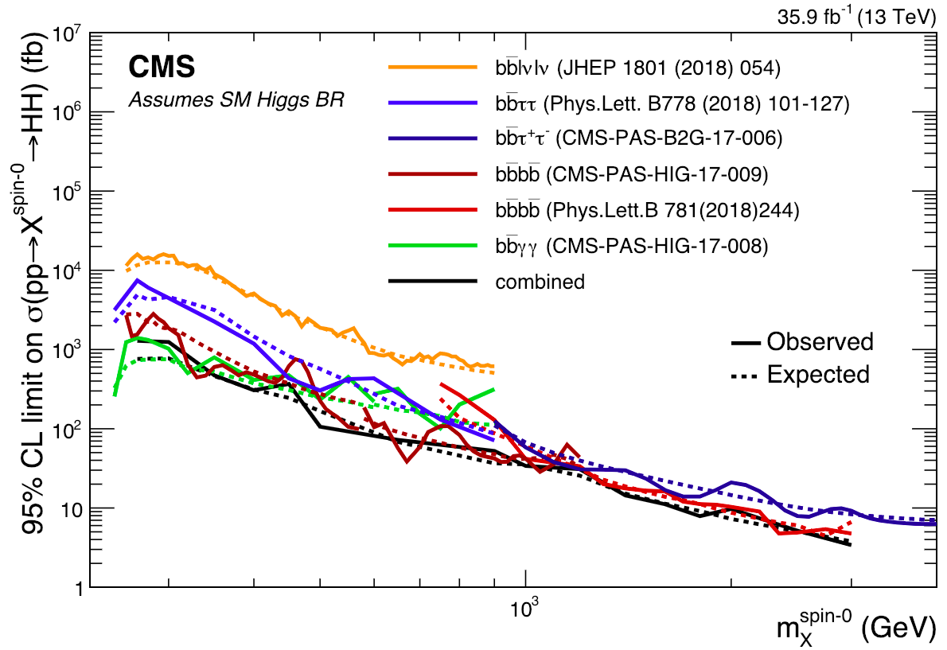
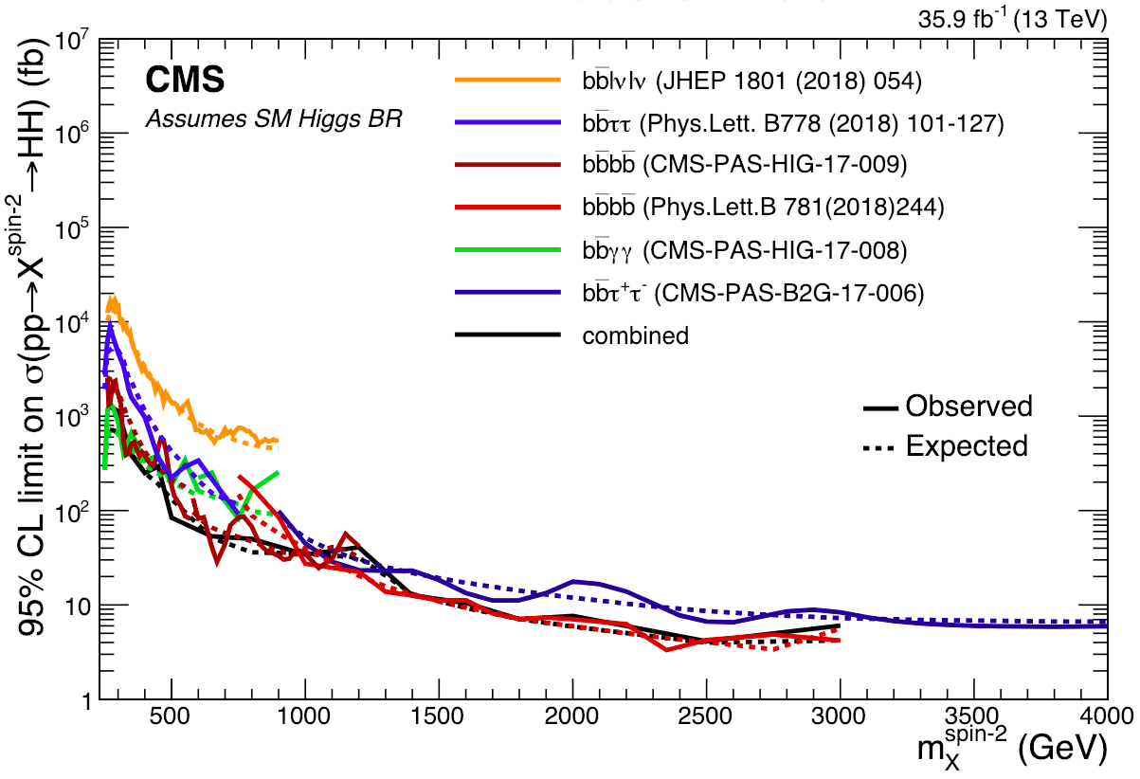
Combination of HH channels
Combination of HH channels using 2016 data. Expected (dashed) and observed (solid line) 95% CL exclusion limits are shown. The results describe the production cross section of a narrow width spin 0 (left) and spin 2 (right) resonance decaying into a pair of SM Higgs bosons.

Slide 76
Particles traversing CMS

Slide 77
Interactions with the detector material
Muon: passing through CMS, bending in the field (both ways, depending on when it is inside or outside of the solenoid) leaving hits in the Tracker layers and the muon chambers before escaping completely
Electron: Bending in the magnetic field, leaving hits in the tracker layers and being “stopped” by the electromagnetic calorimeter
Charged hadron: Bends in the magnetic field and leaves signals in the tracker layers; passes through the electromagnetic calorimeter leaving essentially no signal, and is “stopped” by the hadron calorimeter
Neutral hadron: Does not bend in the magnetic field and does not leave any signal in the tracker layers; passes through the electromagnetic calorimeter leaving essentially no signal, and is “stopped” by the hadron calorimeter
Photon: passes through the tracker without bending in the magnetic field or leaving hits, is “stopped” by the electromagnetic calorimeter

Slide 78
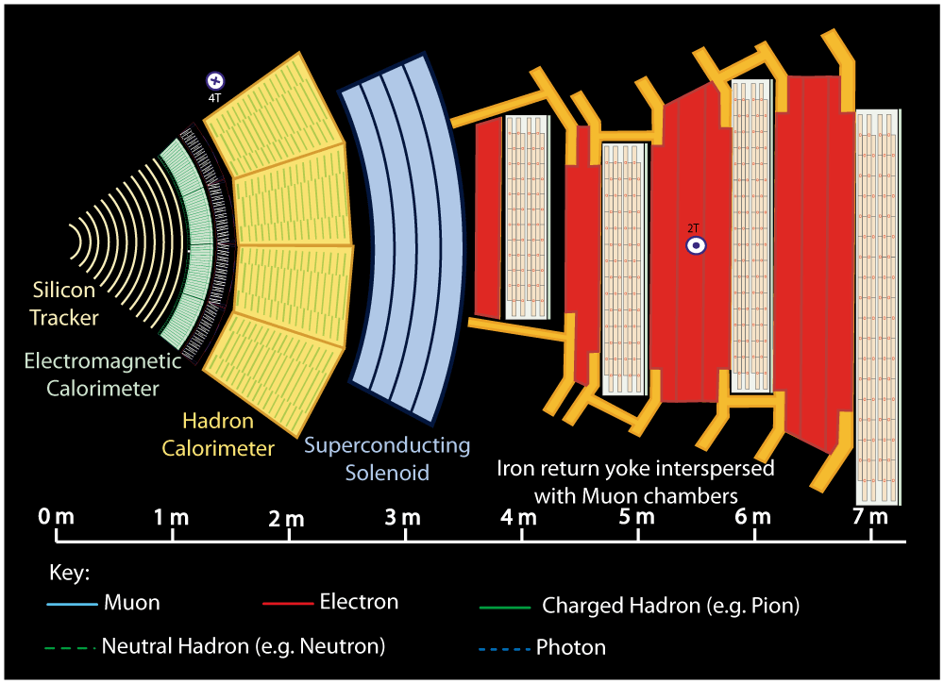
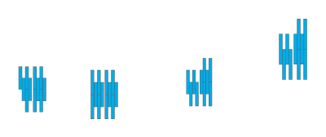


Notes:
Muon: passing through CMS, bending in the field (both ways, depending on when it is inside or outside of the solenoid) leaving hits in the Tracker layers and the muon chambers before escaping completely

Slide 79



Notes:
Electron: Bending in the magnetic field, leaving hits in the tracker layers and being “stopped” by the electromagnetic calorimeter

Slide 80



Notes:
Charged hadron: Bends in the magnetic field and leaves signals in the tracker layers; passes through the electromagnetic calorimeter leaving essentially no signal, and is “stopped” by the hadron calorimeter

Slide 81


Notes:
Neutral hadron: Does not bend in the magnetic field and does not leave any signal in the tracker layers; passes through the electromagnetic calorimeter leaving essentially no signal, and is “stopped” by the hadron calorimeter

Slide 82



Notes:
Photon: passes through the tracker without bending in the magnetic field or leaving hits, is “stopped” by the electromagnetic calorimeter

